Slide 1
LIFE SKILLS
VERBAL PRESENTATION ON ROOT WORDS
V. SIDHARRTH
B.Tech in Artificial Intelligence and Data Science (IIIrd Semester)
ROLL NO. 54

Slide 2
PLUVI
Word Origin: Latin

Slide 3

WORDS FROM PLUVI
compluvium
Meaning: An open space over the atrium of a house through which rain flows.

Slide 4

impluvium
Meaning: A rainwater tank in the middle of house.

Slide 5
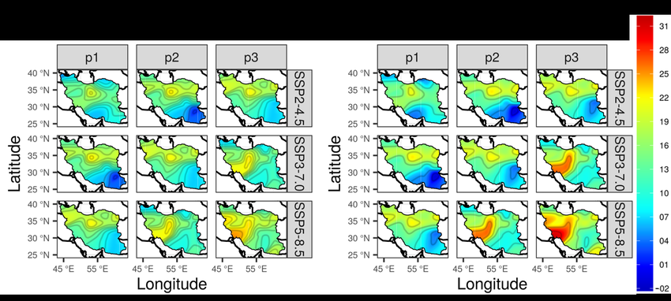
isopluvial
Word Meaning: A line on a chart drawn through geographical points having the same rain.

Slide 6
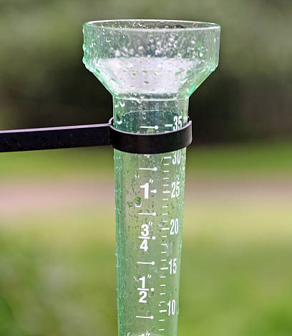
Pluviometric
Word Meaning: A device which assesses the amount of condensation in the atmosphere.

Slide 7
SANGUIN
Word Origin: Latin

Slide 8
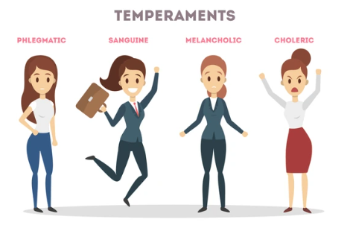
WORDS FROM SANGUIN
Sanguinity
Word Meaning: To be confident and cheerful that everything will work out the way you want it to.

Slide 9
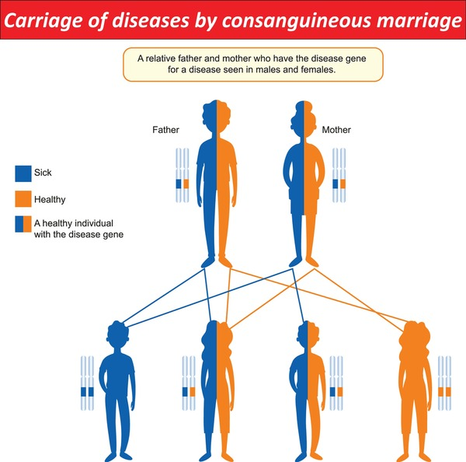
Consanguinity
Word Meaning: The state of being related to someone else by blood or having a similar close relationship to them.

Slide 10

Exsanguination
Word Meaning: the action of draining a person, animal, or organ of blood; or severe loss of blood.

Slide 11
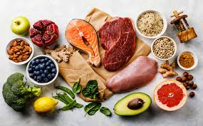
Sanguifacient
Word Meaning: Blood forming

Slide 12


